Slide 1
Online Role-based training resources: Microsoft Learn https://docs.microsoft.com/en-us/learn/

Slide 2
Module 9: Identify Patterns and Trends

Slide 3
Learning Objectives
You will learn the following concepts:
Advanced Analytics
Data Insights through AI Visuals
Notes:
By the end of this module, you’ll be able to:
Use advanced analytics to identify outliers, conduct time-series analysis, and more.
Uncover additional data insights through the use of AI visuals.

Slide 4
Lesson 1: Advanced Analytics

Slide 5
Introduction to Advanced Analytics
Advanced analytics enables organizations to make better business decisions and create actional and meaningful insights.
The emerging power of advanced analytics.
Bring value to an organization through Power BI’s advanced analytics capabilities.

Slide 6
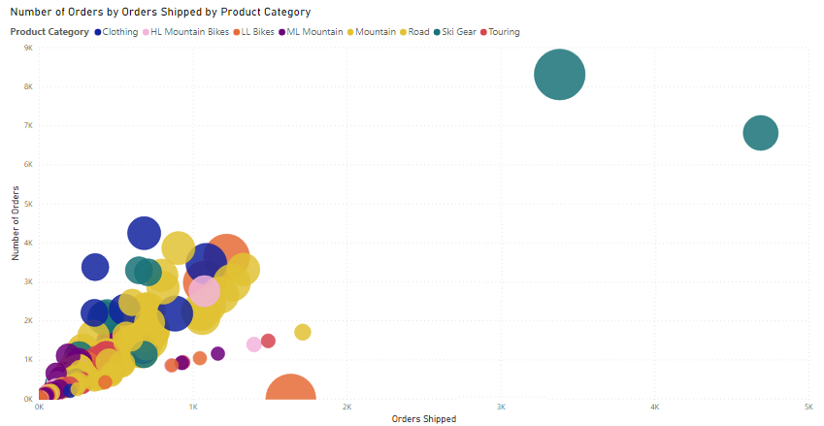
Identify Outliers
Notes:
An outlier is a type of anomaly in your data - something that you didn't expect or that surprised you, based on historical averages or results. You will want to identify outliers to isolate data points that significantly differ from other data points, then take action to investigate the reasons for the differences. The results of this analysis can make a huge impact on business decision making.
For example: You are analyzing data for a shipping warehouse. You notice that the number of orders spiked up above average for a specific product category. You first want to identify which product category it is and ask questions about the outliers.
Was there above average shipments that day?
Was it just a specific warehouse?
Did a single event cause the spike in orders for specific category?
Were there any other days like this in the last month, quarter, year, or prior year?
Power BI allows you to easily identify outliers in your data but you need to first determine the logic behind what constitutes an outlier. You can use trigger points, such as calculations, around what you would consider the outlier to be.
The process of identifying outliers involves segmenting your data into two groups; one group is the outlier data and the other group is not. You could use calculated columns to identify outliers but the results would be static until you refresh the data. A better way to identify outliers is to use a visualization or DAX formula, as these methods will ensure your results are dynamic.
Drilling into the outliers:
Use a visual: The best visual to use to identify outliers is the scatter chart, which shows the relationship between two numerical values. Scatter charts display patterns in large sets of data and are therefore, ideal for displaying outliers.
Use DAX: You can use DAX to create a measure that will identify the outliers in your data. When you have created a new outlier measure, you can group your products into categories using the grouping feature.

Slide 7
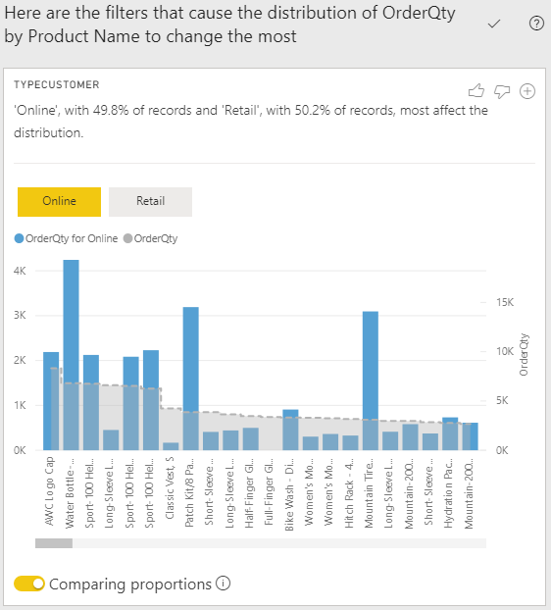
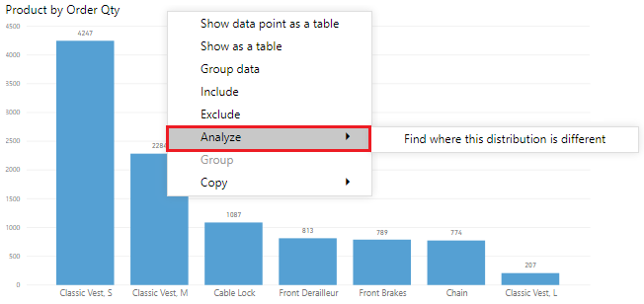
Using the Analyze Feature
Get fast, automated, and insightful analysis on your data.
Notes:
The Analyze feature provides you with additional analysis that is generated by Power BI for a selected data point. You might want to use this feature to see if Power BI has found something that you haven't looked at before, or if you want Power BI to give you a different insight to your data. This feature is particularly useful for analyzing why your data distribution looks the way it does.
Instead of exploring the data manually, you can use the Analyze feature to get a fast, automated, insightful analysis on your data.
NOTE: This feature will not work if you have non-numeric filters applied to your visual and/or if you have measure filters applied.
To use the Analyze feature, right-click a data point on the visual, then hover over the Analyze option to display two further options: Explain the increase and Find where the distribution is different. The options that are available will depend on the data point you selected.
You can add the new visual to your report, so other users can view it. Select the plus icon in the top right corner of the visual to add it to your report.

Slide 8
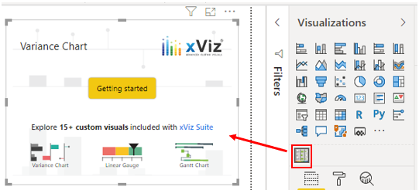
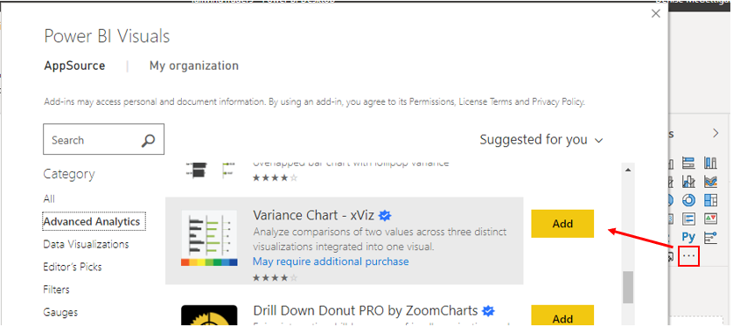
Advanced Analytics Custom Visuals
Add a layer of data insights to your reports for further analysis.
Notes:
In addition to the out-of-the-box visualizations you see in Power BI Desktop, the Microsoft AppSource has a vast library of custom visuals that you can import into Power BI Desktop. These custom visuals give you a wider choice of options when it comes to using advanced analytics. There might be a custom visual that solves a business problem that the standard visuals cannot solve, or one that presents your data in a way that the standard visuals cannot.
These custom visuals include box-and-whisker plots, variance charts, hierarchical trees, Gantt plots, clustering plots, and much more; the list goes on. Using advanced analytics visuals adds a layer of complexity to your reports, and allows you to further analyze the data and develop granularity within your visuals.
NOTE: Some organizations prefer not to use custom visuals at all, or only permit certain custom visuals, for security or other reasons. Before you import any custom visuals, check with your organization to see if they are allowed or not. If they are not allowed, you can still create reports in desktop with them, but they will not render in the Power BI Service.

Slide 9
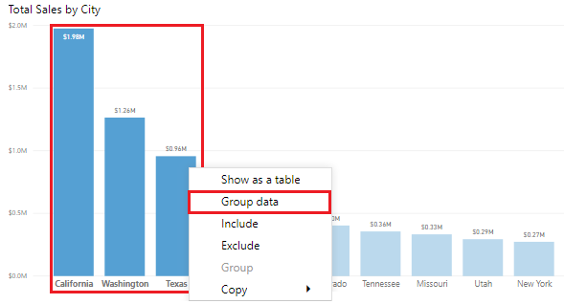
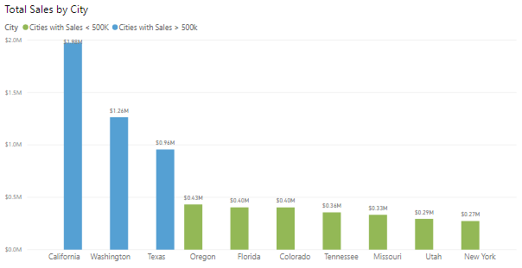
Grouping and Binning
Grouping: Group categories of data.
Binning: Group continuous fields.
Notes:
When you create visuals, Power BI Desktop aggregates your data into groups, based on the values it finds in the underlying data. You can refine how those default groups are presented. Group data points to help view, analyze, and explore data more clearly.
You can also create new groups by grouping two or more data points in a visual or putting values into equal sized groups (binning), that better enable you to visualized data in ways that are meaningful.
Grouping is used for categories of data. Binning is similar to grouping but it is used for grouping continuous fields, such as numbers and dates.
You can use the grouping and binning features to ensure the visuals in your reports display your data exactly how you want them to, so you can more clearly view, analyze, and explore the data and trends in your visuals. You'll be able to identify clusters, patterns of behavior, data averages, and more. The results of this analysis will provide your end-users with more specific insights on their data, which can drive business decisions.
Create a group: To create the group, you start by using Ctrl+click to select the data points on the visual that you want to group. Right-click one of those selected data points and select the Group data option.
When the group is created, you'll see that the visual updates to take account of the new group.
Easily edit existing groups by tight-clicking the field from the Legend bucket or from the Fields list, and then choose Edit Groups.
The process of binning allows you to group your numerical and time field data into "bins" of equal size, so you can visualize and identify trends in your data in more meaningful ways. Binning allows you to right-size the data that Power BI Desktop displays.

Slide 10
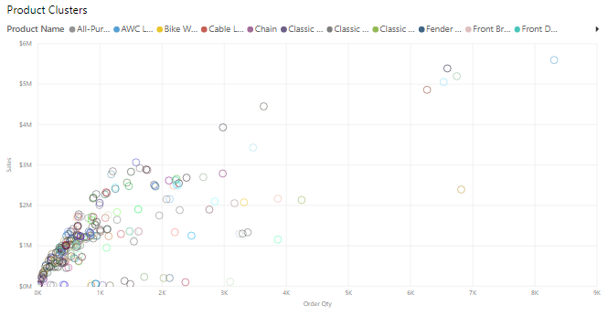
Clustering Techniques
Notes:
Clustering allows you to identify a segment (cluster) of data that is similar to each other but very dissimilar to the rest of the data. The process of clustering is different to that of grouping, which you did earlier.
The Power BI clustering feature allows you to quickly find groups of similar data points in a subset of your data. It analyzes your dataset to identify similarities and dissimilarities in the attribute values, then it separates the data that has similarities into a subset of the data. These subsets of data are referred to as clusters.
Start by adding the Scatter chart visualization to your report, then add the required fields to the visual.
To apply clustering to your scatter chart, select More options (...) in the top right corner of the visual, and then select Automatically find clusters.
On the Clusters window that displays, you can edit the default name, field and description, if required.
NOTE: Leaving the Number of clusters box is blank means Power BI automatically finds the number of clusters it thinks makes the most sense with your data.
The new cluster field is added to your scatter chart's legend field well bucket, which you can now use as a source of cross highlighting like any other legend field. You can also find it in your field list and use it in new visuals, just like any other field.

Slide 11
Review Questions
1
Q – What Power BI feature can give an in-depth analysis of the distribution of data?
A – The Analyze feature allows a user to understand why the distribution of data looks the way it does.
2
Q – What visual should be used to display outliers?
A – The scatter chart displays outliers.

Slide 12
Lesson Review
Advanced analytics enables organizations to make better business decisions and create actional and meaningful insights.
The emerging power of advanced analytics.
Bring value to an organization through Power BI’s advanced analytics capabilities.

Slide 13
Lesson 2: Data Insights through AI Visuals

Slide 14
Introduction to AI Visuals
Power BI provides a wide range of methods to analyze data.
Fastest way to get an answer is to ask a question.
Analyze raw data and transform it into valuable information.

Slide 15
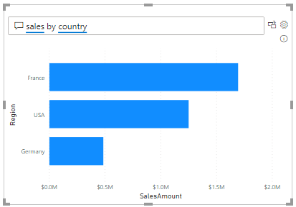
The Q&A Feature
Explore data in your own words.
Ask natural language questions.
A “self-help” feature for insights the user is interested in.
Notes:
The Q&A feature in Power BI lets you explore your data in your own words, by allowing you to ask natural language questions, and then answering those questions for you.
This ability to ask questions is valuable to both you, as the report author, and your report users. It gives you ideas for the type of visuals you can display in your report, and lets you quickly add those visuals. It gives your report users an effective tool they can use to get quick answers to their questions about the data, independently. This self-help aspect to Power BI saves time for everyone involved.
Power BI records all of the questions that are asked, and you can use this information to set up the Q&A feature to be more effective. When the Q&A feature answers so many questions, you'll have less people coming directly to you looking for those answers.
Set up the Q&A Feature:
You can set up the underlying Q&A feature so that it becomes better at answering questions about your data. You basically teach the Q&A feature to understand people better.
Proactively monitor and review the questions that are coming through from users, then and address misunderstandings or common typos.
Manage the key terms associated with your data, so you can add a library of synonyms that may be used by different users across the organization when asking questions about the data.
Fine-tune the Q&A feature, so it provides better answers to your organization's questions.
Build visuals with the Q&A feature:
When Power BI answers a question and you find the visual result interesting or helpful, you can add it as a standard visual on your report.
To turn a Q&A result into a standard visual, click the icon next to the question box.
The Q&A feature is unique in that it does not require knowledge of Power BI to use the visual, users simply have to ask their question and they too can create insightful visuals.

Slide 16
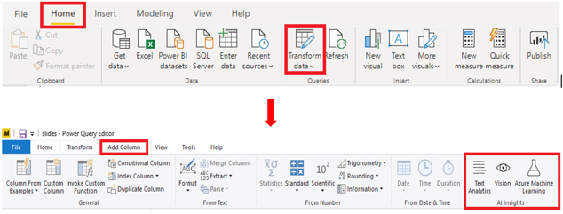
AI Insights
Connect to a collection of pre-trained Machine Learning models.
Notes:
The AI Insights feature allows you to connect to a collection of pre-trained machine learning models that you can apply to your data, to enhance your data preparation efforts.
AI Insights is accessed in the Power Query editor, and its associated features and functions are accessed through the Home and Add Column tabs in Power Query editor.
With Text Analytics and Vision in Power BI, you can apply different algorithms from Azure Cognitive Services to enrich your data in Power Query. The services that are supported today are the following:
Sentiment Analysis
Key Phrase Extraction
Language Detection
Image Tagging
NOTE: Premium capacity is required to use the Text Analytics and Vision options.
NOTE: If you do not see these options, you need to enable the AI Insights feature in the Power BI Desktop settings. Go to File > Options and Settings > Options. In the Global options list, select Preview Features, then select the check box for the AI Insights function browser option, and then select OK.

Slide 17
Review Questions
1
Q – Can you access the Q&A feature by using buttons?
A – Yes, you can access the Q&A feature by selecting the Q&A button type.
2
Q – What is not a feature of the Q&A feature?
A – Searching for help topics about Power BI.

Slide 18
Lesson Review
Use the AI aspects of advanced analytics in Power BI to dig deeper into data.
Use AI to answer more business questions.
Use AI visuals to understand factors affecting a metric or view data across multiple dimensions for root cause analysis.

Slide 19
Lab: Perform Data Analysis in Power BI Desktop
Lab: Perform Data Analysis in Power BI Desktop

Slide 20
Module Overview
We covered the following concepts:
Advanced Analytics
Data Insights through AI Visuals
Notes:
In this module we discussed:
How to use advanced analytics to explore statistical summary, identify outliers, conduct time-series analysis, and more.
How to uncover additional data insights through the use of AI visuals

Slide 21

References
PL-300 Perform analytics in Power BI
https://docs.microsoft.com/en-us/learn/paths/perform-analytics-power-bi/
PL-300 Work with AI visuals
https://docs.microsoft.com/en-us/learn/modules/ai-visuals-power-bi/
Notes:
It is good practice to tie back your ILT deliveries to role-based learning materials on Microsoft Learn. What is listed here should supplement your delivery and the role-based training your course is affiliated with. It is important to give the learners continued education opportunities for growth.
Steps:
Insert the page title here along with the url to other Microsoft resources.
It is only necessary to duplicate this slide if there are more than 6 references that need to be shared with the students.

Slide 22
Closing slide

